Slide 1
Cisco Project
Quantum Network Solutions
Alejandro Hernandez, Ha V, Kevin Nguyen

Slide 2
Overview
Quantum Network Solutions is an organization that uses a true business consultative approach to determine clients’ requirements and architects innovative and synergistic IT solutions to meet clients’ needs.

Slide 3
Requirements
Main office located in Austin.
Branch 1 is in Oklahoma City and Branch 2 is in Phoenix
Create single-area OSPF, Point-To-Point, Security, and Redundancy
NAT/PAT Translation
Use Multi-layer switches on each floor with redundancy
Remote VPN strategy
Frame Relay WAN Provider
Wireless Access Point
Serial to represent T-Carrier line

Slide 4
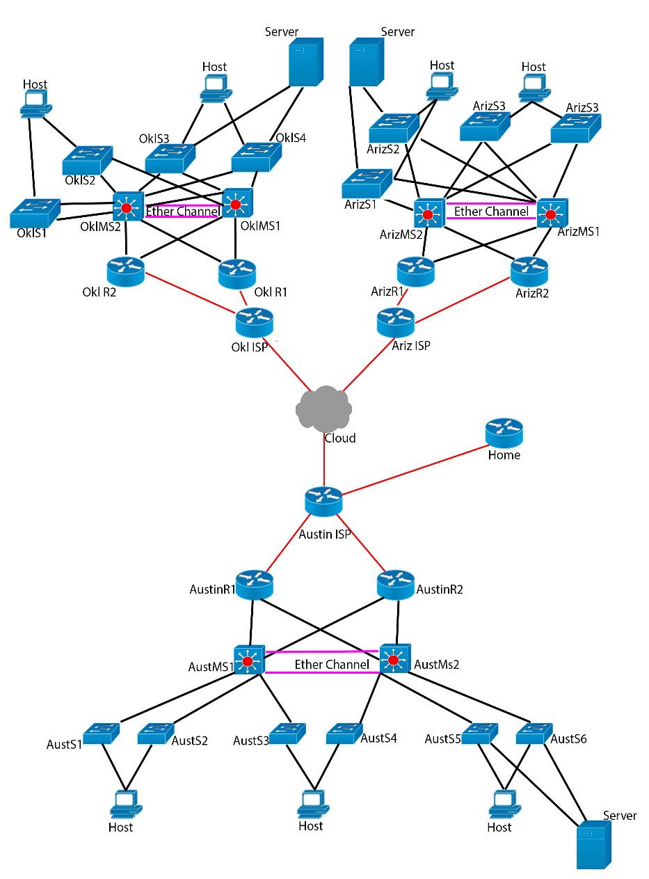
Design Plan
The Central Office will be in Austin.
Norman and Phoenix will be separate branch training centers.
Single area OSPF with frame relay as a WAN technology.
A Data Center for data storage.
CyrusOne servers located near the airport in Austin.
Each PC will have IPv6 addresses assigned.

Slide 5
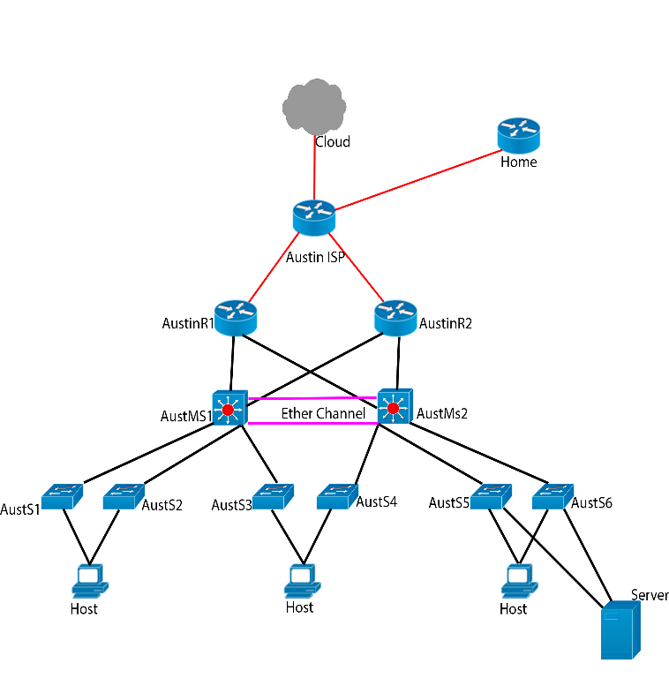
Austin Main Branch
Consisting of 3 floors
Administration and IT Offices
Network assigned 172.16.0.0/16
1st floor – Administration, IT, and Server Farm
Admin – VLAN 11
IT – VLAN 3
Server – VLAN 10
2nd floor – Six classrooms
Classrooms – VLAN 2, 4, 5, and 6
3rd floor – Six classrooms
Classrooms – VLAN 7, 8, and 9

Slide 6
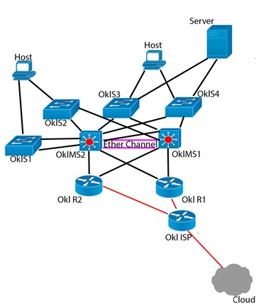
Norman, Oklahoma
Consisting of 2 floors
Administration and IT Offices
Network assigned 172.17.0.0/16
1st floor – Administration, IT, and Server Farm
Admin – VLAN 11
IT – VLAN 3
Classroom – VLAN 3 and 5
2nd floor – Six classrooms
Server – VLAN 10
Classrooms – VLAN 5, 6, and 7

Slide 7
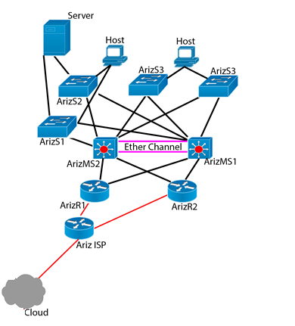
Pheonix, Arizona
Consisting of 2 floors
Administration and IT Offices
Network assigned 172.18.0.0/16
1st floor – Administration, IT, and Server Farm
Admin – VLAN 11
IT – VLAN 3
Classroom – VLAN 3 and 5
2nd floor – Six classrooms
Server – VLAN 10
Classrooms – VLAN 5, 6, and 7

Slide 8
Security
Only the network allowed in the access list should be able to access the Internet.
Else if violation occurs, the port will be shutdown. Also all unused port will be shutdown.

Slide 9
Single-Area OSPF
The routing protocol chosen is OSPF, which is a link-state protocol that calculates the shortest route to a destination.

Slide 10
Collapsed Core Layer
The collapsed core design is intended to reduce network cost, while maintaining most of the benefits of the three-tier hierarchical model.
Etherchannel aggregation provides fault-tolerant high-speed links between multi-layer switches, routers, and PCs. Used to increase the bandwidth between the multi-layer switches and the data center.

Slide 11
Access Layer
Multilayer switches are configured with DHCP on PCs and the servers will have a static IP address.
DHCP will be implemented with a DHCP pool, excluding the first 10 IP addresses.

Slide 12
Redundancy
HSRP routes IP traffic without relying on the availability of any single router. It enables a set of router interfaces to work together to present the appearance of a single virtual router or default gateway to the hosts on a LAN.

Slide 13
Spanning-Tree
BPDU Guard is a basic feature that will automatically shut down a port when BPDU’s are received on that particular port.
BPDU Guard are assigned to host access ports to detect loops in a network topology, then the port will shutdown.

Slide 14
Devices
The server will have static IP addresses for security and reliability purposes.
The PCs will have DHCP addresses assigned.
The website accessible is: “quantumnetworksolutions.com”

Slide 15
NAT/PAT Translation
NAT and PAT will translate private addresses to public allowing users to reach the internet.
The private address block will be 172.16.0.0/16.
The public address block-NAT/PAT will be 196.20.30.0/24.

Slide 16
WAN Frame Relay
The cost of the T-Carrier line for Verizon will cost $330 and it will be represented as the serial cable to the ISP in each location.

Slide 17
Remote Management
Only IT Support department will be able to SSH to the router.

Slide 18
Wireless Access
Wireless Access Point will be available at their location for wireless devices.

Slide 19
VPN Strategy
Home will be able to use remote VPN to the Austin Router.

Slide 20
Network Monitoring
Using the simulation and sniffer device to monitor packets.

